Slide 1
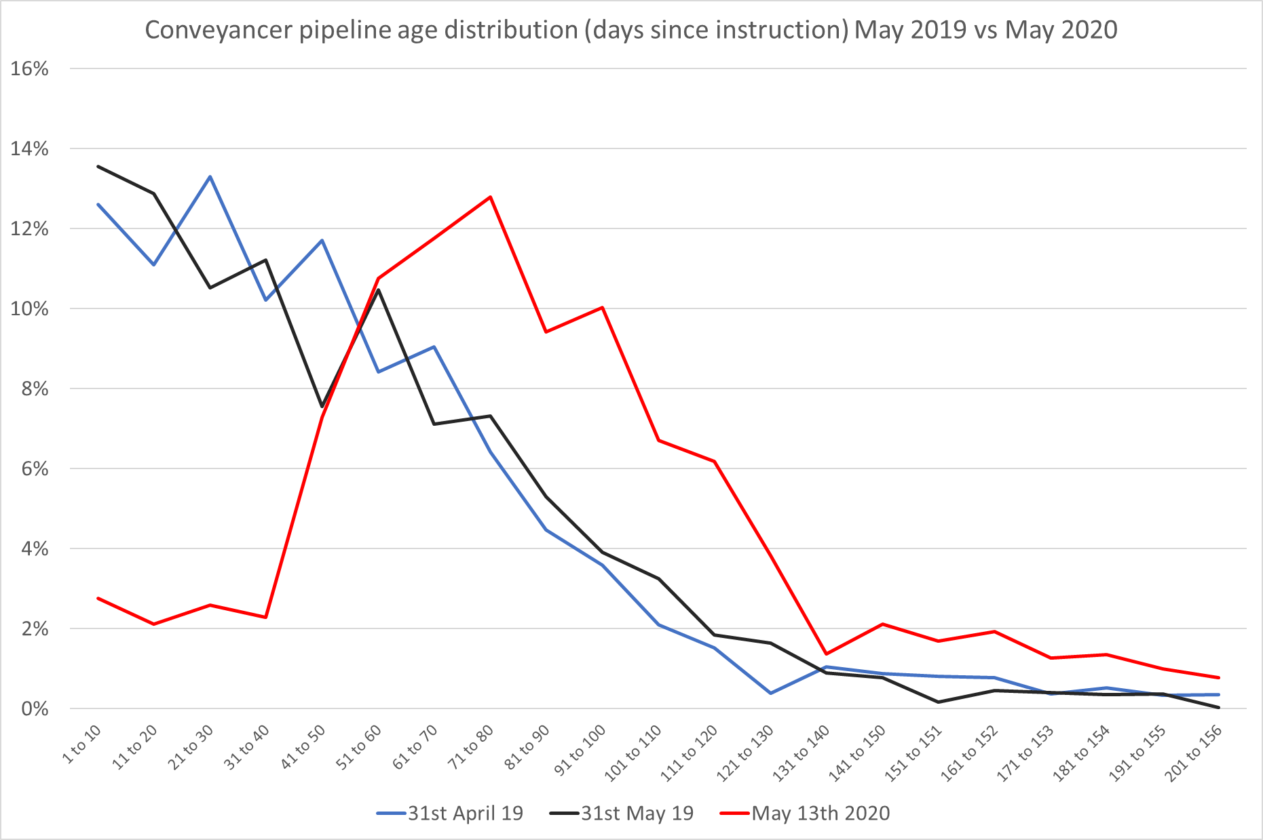
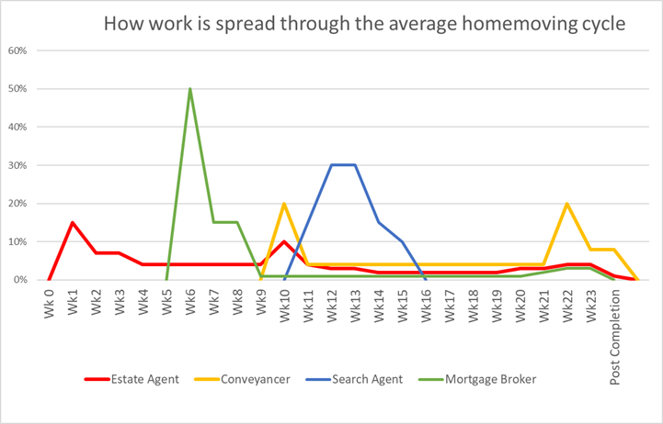
A
B
Ave % of activity per week
Average Completion is 13 weeks
80% +/- 30 days of average
% of pipeline of active cases
C
D
Days since instruction
The forecast spike in conveyancing activity / resource required (next slide) is a result of the larger % of cases than normal that have been progressed during the lockdown and are now close to completion (A to B). Cases in the period immediately prior to and following exchange and completion (C) require more significantly more input (per case / per week) than cases that are ‘mid-flight’ (D). Completion related activity will not reach ‘normal’ levels until c.13 weeks after live instruction levels return to ‘normal’ which in itself won’t be until c.8 weeks after property listings return to normal.
This means that there is likely to be a spike of activity in the short term followed by a slow build.

Slide 2
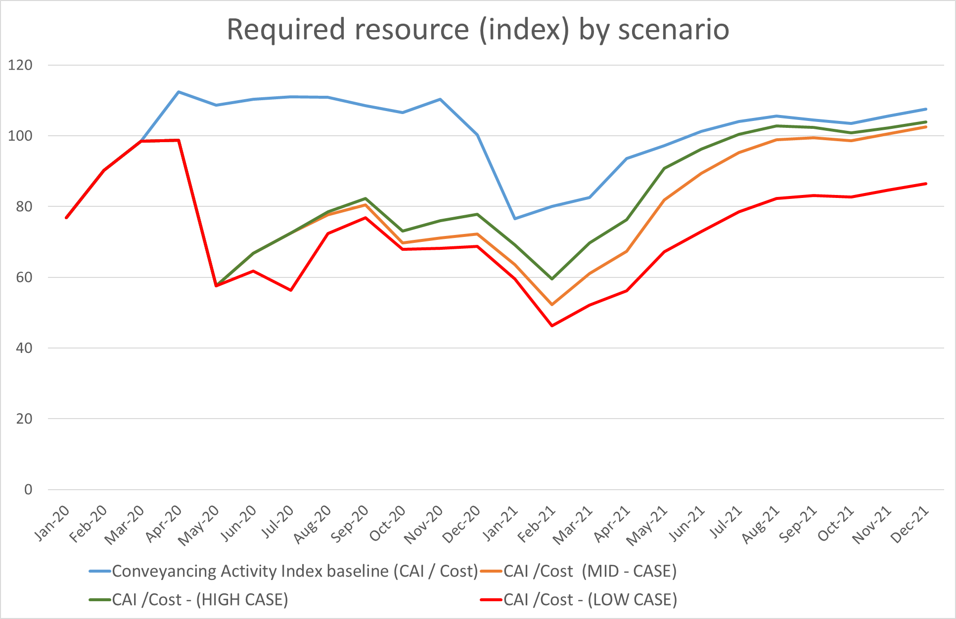
Having reduced substantially during lockdown, after restrictions are eased, activity levels for pipeline businesses (such as conveyancers) will build steadily, driven by timing and volume of new instruction and completions
Resourcing scenarios
A – Lockdown has had a significant impact on resourcing requirements as new work has dried up and activity on existing transactions has diminished because most cannot complete. Much of the resource required during lockdown is not generating any short-term cash receipts but is required simply to deal with customer requests for updates.
B – The end of ‘lockdown’ will likely result in a mini-surge of completions of “mature” cases, causing a short-term requirement for resource which will then reduce until the pipeline of new cases has had time to build (which is time lagged after new listings per previous slide)
C – Activity will then start to grow steadily as a result of new instructions and a growing pipeline
D – The seasonality of the market (low market-driven completions in Dec-Feb in blue bar) is unavoidable but should not detract from the underlying recovery which continues to increase the need for resource (E) after the seasonal low point
A
B
C
E
Index of activity (100 = average monthly activity 2019)
D
Required resource index is based on typical activity shape for conveyancers but, in aggregate, will also be representative for other industries whose volumes depend on property listings flowing through to completions
Standard seasonal downturn
LOW Case = July restart, 12 month recovery to 85% of normal listings volume
MID Case = June restart, 12 month recovery to 100% of normal listings volume
HIGH Case = June restate, 6 month recovery to 100% of normal listings volume
2

Slide 3
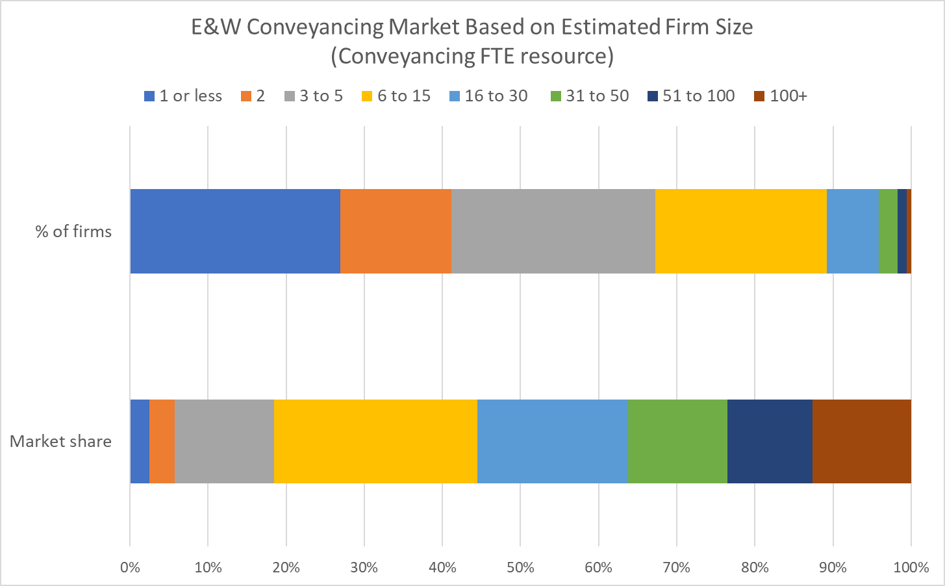
Source: HMLR Transactions for Value Data - March 2020.
Translation to estimated FTEs is based on 0.33 of all mover conveyancing transactions (sale or purchase) appearing in March HMLR data and an assumed market average of 6 case completions per staff member per month (including operational support staff)

